Slide 1



REST APIs and
GraphQL

Slide 2


Objectives
Understand what is REST API
Use APIs at localhost
Work with Driver API
Test APIs with Postman

Slide 3
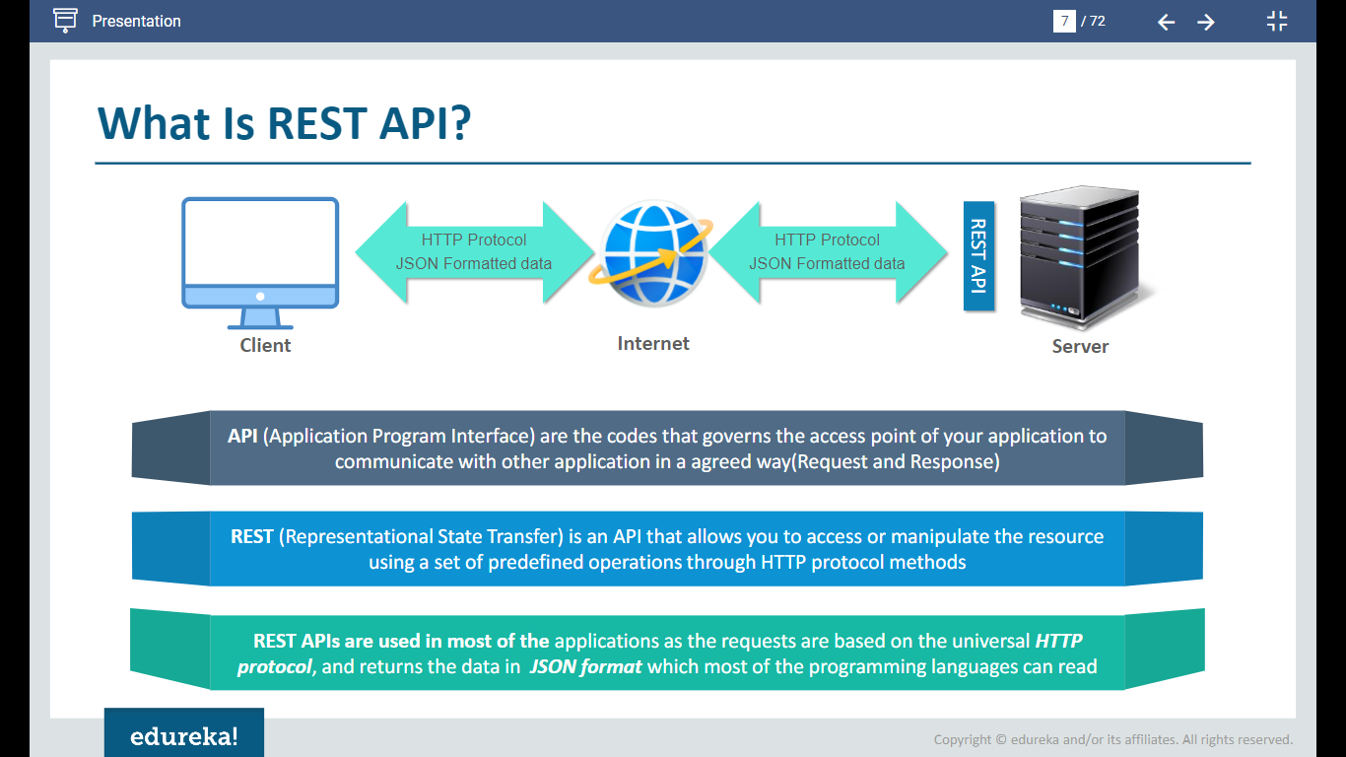
What is REST API?
API(Application Program Interface) are the codes that governs the access point of your application to communicate with other application in an agreed way (Request and Response).
REST(Representation State Transfer) is an API that allows you to access or manipulate the resource using a set of predefined operations through HTTP protocol methods.
REST APIs are used in most of the application as requests are based on the universal HTTP protocol and return the data in JSON format which most of the programming languages can read.

Slide 4
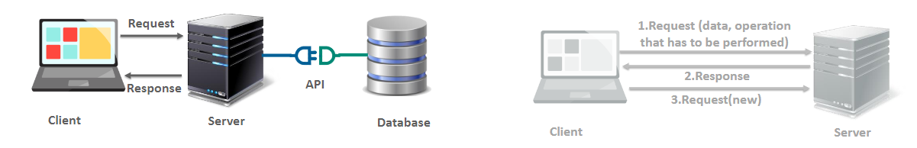
What does Representational State Transfer mean?
Representational
State Transfer
It means that we can work with the representation of the data.
It means that the state has been transferred from server to client as the server does not store any state about the client session.
For Example, the data is stored on the database but with the help of REST API you can create, fetch, update or delete the data through your application in your server.
For Example, A Client request must contain all the details required to process the request, the server just process the request and return the result but it does not store any state of the client session.

Slide 5
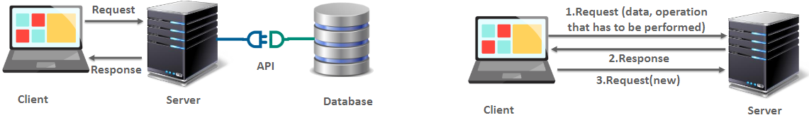
What does Representational State Transfer Mean?
Representational
State Transfer
It means that we can work with the representation of the data.
It means that the state has been transferred from server to client as the server does not store any state about the client session.
For example, A Client request must contain all the details required to process the request, the server just process the request the results but it does not store any state of the client session.
For example, the data is stored on the database but with the help pf REST API you can create, fetch, update or delete the data through your application in your server.

Slide 6
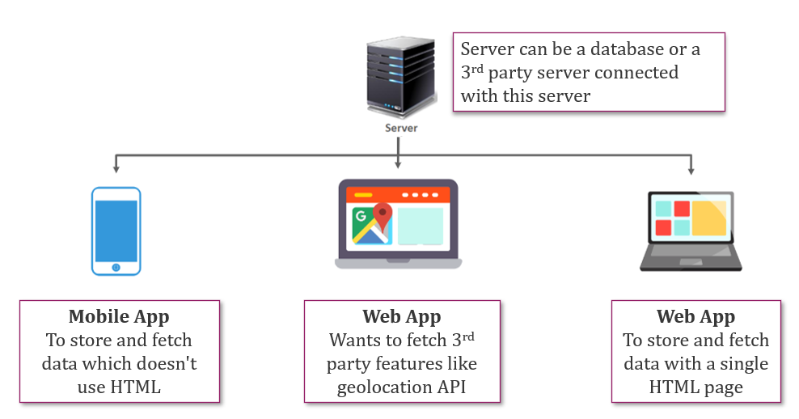
Where do we use REST API?

Slide 7
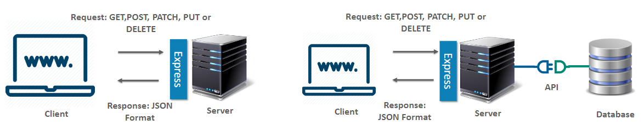
Express-REST API
Express provides REST API to
Get the user request to our app and send response back to the client.
Access the Database from front-end

Slide 8

HTTP Methods
Create
POST/ endpoint
Read
GET/ endpoint
Update
PATCH/ endpoint/ :id
PUT/ endpoint/ :id
Delete
DELETE/ endpoint/ :id

Slide 9

POSTMAN

Slide 10
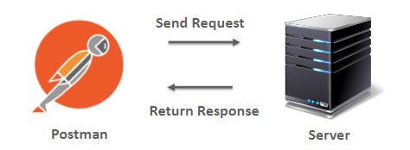
What is Postman?
Postman is an application for testing APIs, by sending request to the web server and getting response back.
The Goal is to test our REST API without a client
Provides collection of API calls
Allows users to give header, body and many more that the API expects and check the response

Slide 11
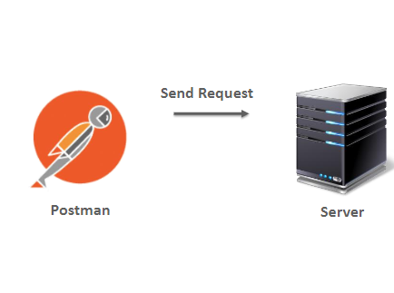
Working of Postman
To make a valid request, the things required are
URL
Method
Header
Body
Specifies what resources the request wants to access to
Example: http://XYZ.com
HTTP Method to perform action i.e., PUT, GET or DELETE.
Provide Meta-data about a request that is made by user.
Body contains the data that has to be sent to the server for processing the request.

Slide 12
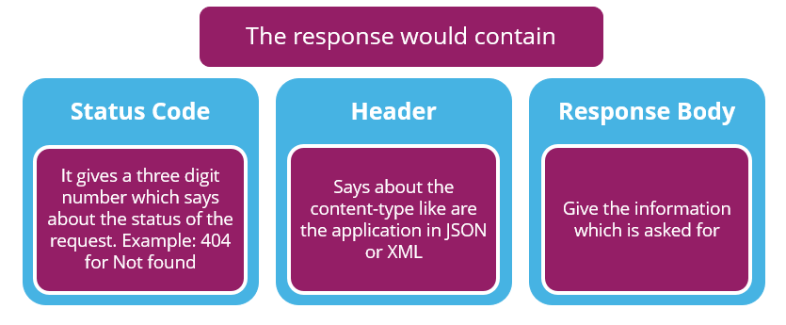
Working of Postman

Slide 13
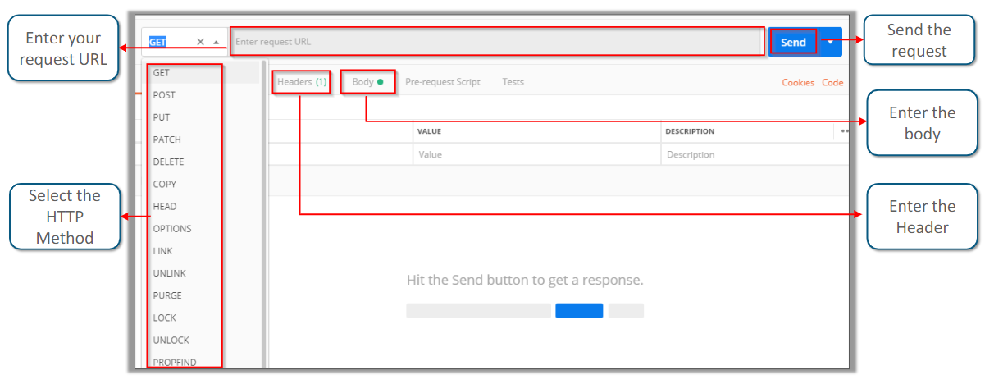
Install Postman
Install Postman from the link: https://www.getpostman.com/download / and run it to install it.

Slide 14
Thank You

